Slide 1

Tracing Your Lineage
April 27, 2023
Norma M. Milne
Lakes Region Genealogy Interest Group

Slide 2
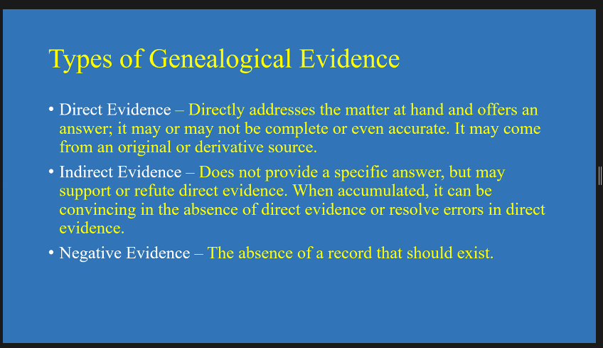
HAVE MUCH PATIENCE!

Slide 3
Where do I begin?
Begin by stating in concrete terms what you want to accomplish – be specific.
Example: I want to discover when and where my maternal g-g-grandparents arrived in the US. I want to trace my XXXX family back to their home country.
Next, start with what you do know – Yourself (Start a Family Group Sheet)
Chronicle yourself and research backwards – because you are the easiest to find information on! Success breeds happiness in genealogy.
Tell a few relatives what you are doing. Use a Family Questionnaire worksheet, if possible, to capture details. If they are hesitant to divulge information, move on.
Talking to “Aunt Marjorie” – it may result in unknown information about family secrets
Find “patterns” with names, locations, and hidden tips. If looking at a census record, look for neighbors who may be relatives. (next slide)
Don’t worry about surname variations

Slide 4
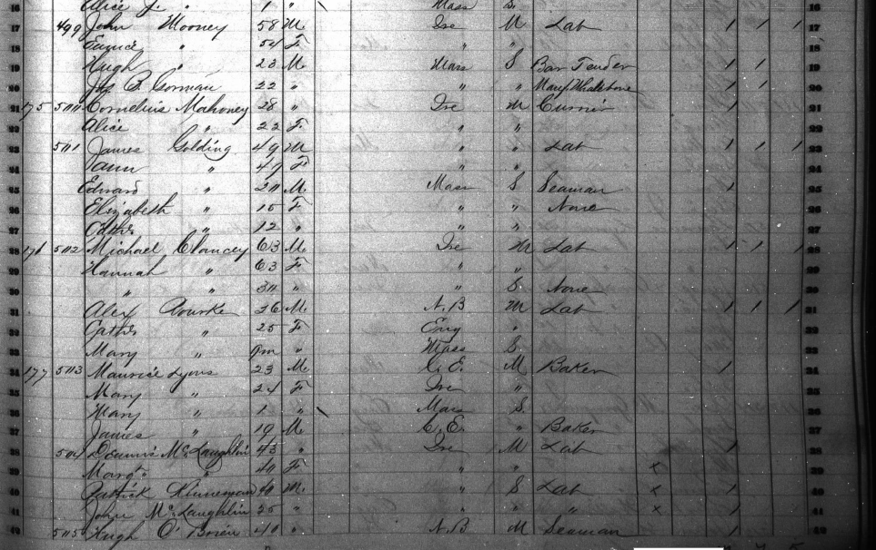
John Mooney’s mother’s maiden name was Mary McLaughlin

Slide 5
RECORDS AND KEEPING TRACK -
Use templates to record what you have found. Saves time and avoids “where did I finish last time I worked on this line?” (oh, those rabbit holes)
Check out our forms at: https://lakesregiongenealogy.wordpress.com/
Use what you are comfortable with, but be consistent
If you are using paper: Use the Family Group Sheet and a Research Plan form (display)
If you are familiar with Google Sheets or Excel – these are great for tracking location of a family over time, esp if they are listed in city directories and for identifying gaps. (Show my Mooney Directory Spreadsheet)
Free forms are also available: https://www.familysearch.org/wiki/en/Use_Appropriate_Forms
https://www.irishfamilyroots.com/getting-started (generic use)
See the Next slide for saving your information

Slide 6
WHERE AND HOW WILL I SAVE WHAT I HAVE FOUND? – So Many Options!
Save precious papers in a binder, set up by Family Name but scan and save important items which, if lost, would be difficult to recreate
Use a software program, which allows you to attach images and documents
Free software programs, such as RootsMagic.com – their essential program is free; FamilySearch.org is free to sign up for. Remember that much of the information in FamilySearch or in Ancestry Trees are entered by individuals/volunteers so verify what has been done. Watch out for “duplicate” individuals/families. In FamilySearch, living individuals are “privatized” – In Ancestry, set up your “Privacy Settings” (publicly viewed or private)
If keeping paper files, use different color folders to identify family surnames/lines and have a portable file if you plan to visit a library – Easy to identify later!
If using your laptop or desktop, where are you saving your information/scans? Structure your folders under “Documents/Genealogy/FamilyName” and then set up subfolders by Generation #s to separate your items.
Keep family stories you have written in a separate subfolder such as “XXX Family Stories” - same with cemetery photos, family photos, etc
THE RULE OF THREE 1) Keep hard copy only for what is very important or difficult to recreate 2) Scan or Save to your PC/Laptop 3) Back up your folders on a thumb drive or external drive OR Save to the Cloud for posterity – Dropbox, Google Drive or a program such as Carbonite.
Look for ideas at: https://www.familysearch.org/en/wiki/Organizing_Your_Files

Slide 7
WHAT IS NEXT? YOUR RESEARCH, OF COURSE!
Complete all of your US research – HOW? (I assumed you have located Vital Records!)
Find your ancestor(s) in every US and State Census & online documents – Use FamilySearch “wiki” to locate state census information
Remember that town, county and state boundaries changed over time
Look into city and town directories, tap into town annual reports for birth, marriage and death information (State libraries, Historical Societies)
Example: https://www.cambridgema.gov/historic/researchaids#family-history-research
Where did they live, what were their occupations? – Why was the occupation of “boilermaker” important in the mid-1800s? Use Google to find out.
Review your copies of marriage, birth and death records – seek CLUES to the past
Review baptism records (hints – godparents/witnesses may be relatives) Family Bibles?
Use the FAN method: Friends, Associates, Neighbors
Once you locate the country of origin, learn about migration patterns (show FamilySearch.org Research Wiki)
Great free resources: - http://thfhguide.com - https://www.cyndislist.com https://www.archives.gov/research/genealogy
Use your local library – either in person or via internet – what subscription databases can you access for free? WPL carries FamilyTree Magazine.

Slide 8
Other Resources to investigate:
School records and yearbooks are now being digitized (Ancestry.com)
Search newspapers for obituaries, marriage announcements, probate notices, court records, ask your librarian Examples: Library of Congress: Chronicling America for major newspapers - free; newspapers.com – a subscription required – see Cyndi’s list website; theancestorhunt.com - free
Use “Google” – Books, records, images
https://www.worldcat.org/ - find books and publications in libraries near you.
https://www.archives.gov/ for military records (Fold3 – subscription or visit a Family History Center)
Need access to images in FamilySearch.org that you can’t view online? If your library is an “Affiliate” member of this organization, you can view more images than an at-home version. OR make an appointment to visit a Family History Center. (Wolfeboro, Exeter, others open by Appt)
https://www.familysearch.org/en/wiki/Introduction_to_Family_History_Centers
See next slide for a list of what is available via their portal

Slide 9
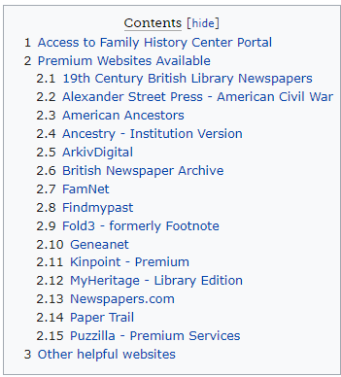
Family History Center Information – subject to change:

Slide 10
I think I have completed my US Research – What is NEXT?
Did you find an immigration record or ship manifest via your research? Many records were from the port of departure, not the arrival.
Was there a naturalization record? Prior to 1906, many could be in a court record, after 1906 they tend to contain more specific information.
Save time and use the Research Wiki in FamilySearch.org
Then, narrow down by country and specific documents you are seeking
(Example: Azores)
https://www.familysearch.org/en/wiki/Azores,_Portugal_Genealogy
Search for databases specific to the nationality you are researching.
Facebook has many heritage groups which are helpful. Example: https://www.facebook.com/groups/323211144363
Subscribe to Family Tree Magazine (Yankee Publishing) they include many research guides
https://www.cyndislist.com/us/
Join a local Study Group or ask your research librarian if the library will start a study group.
Attend webinars and zoom meetings to pick up tips relating to your brick wall.

Slide 11
DNA Testing – is Genetic Genealogy
Are you ready?
DNA testing has been very helpful to many individuals
You can locate cousins, siblings, even biological parents and make connections if traditional genealogy research is limited by privacy rules or lack of records
If you locate “matches” those individual may have completed a family tree and are willing to share, or answer questions
Many list their contact info, often email address.
Join a “group” to broaden your scope and connect with like minded researchers
Not an answer by itself, but helpful. Go to YouTube for many beginner sessions on using DNA, GEDMATCH, etc
Always be respectful of another person’s desire “not to talk about it.”

Slide 12
What will happen to my Records?
Consider that your records and research are as valuable as your other assets
Discuss your interest in family history with family members
Who has the interest in preserving your research? Ask!
Complete a Genealogy Codicil to your will
Share this upfront with those who will be named
OR, speak with your local historical society to determine if their repositories would hold your books, family bibles and your research papers

Slide 13
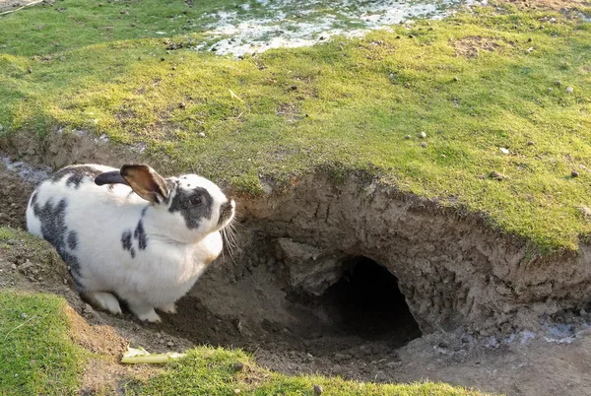
GO DOWN THE RABBIT HOLE AND ENJOY THE JOURNEY!

Slide 14

Use a genealogy workflow to keep organized. Here is a sample outline:
Use a Research Plan document: https://lakesregiongenealogy.wordpress.com
Research plan reviewed.
Search for the needed record(s).
Source citations recorded – Do this now! You won’t remember later.
Read/analyze the record.
Download the record.
File the record.
Add the record to the family tree, if applicable
Repeat the above process for each record
At the end of the research session:
Review the findings
Update the research plan
​

